Slide 1









CONSUMER DATA ENGINEERING
RITIK JANARDHAN KOLI
MySQL
Kafka
Spark
Cassandra
Play APIs

Slide 2


















PROBLEM STATEMENT
Need
Consolidate customer transactions and behavioral events
Unified DE Ecosystem
Goal
Build unified DE ecosystem with MySQL, Cassandra, Kafka, Spark, Parquet, Play APIs
MySQL
Kafka
Source System
Message Bus
Data Sources
Spark
Cassandra
ETL Processing
Storage
Customer Master
Transactions
Behavior Events
Play APIs
REST Interface
2/21

Slide 3
















SOLUTION & APPROACH
A four-step approach to building a unified data ecosystem:
1
Data Ingestion
2
ETL Processing
3
Storage
4
API Layer
MySQL sources
Spark Batch
Cassandra
Play Framework
Kafka message bus
Spark Streaming
Parquet files
REST APIs
Key Benefits:
Real-time + Batch
Data Quality
Performance
3/21

Slide 4
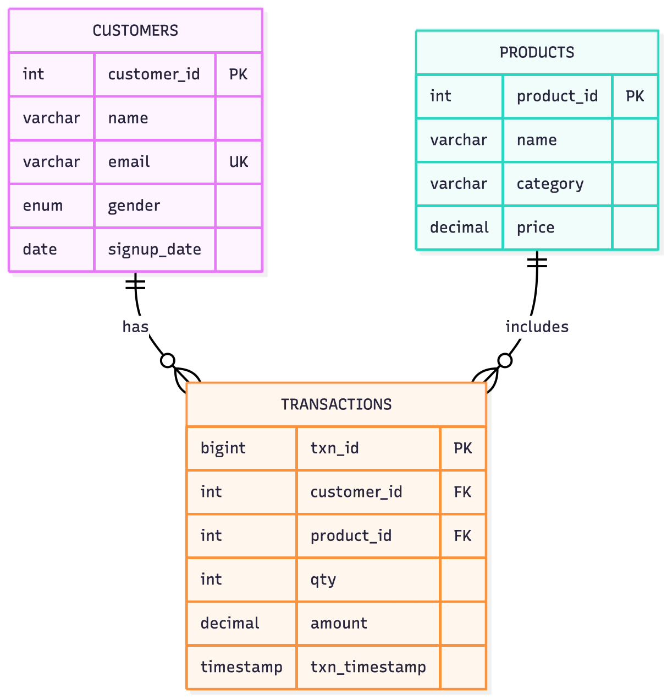

ER DIAGRAM
4/21

Slide 5
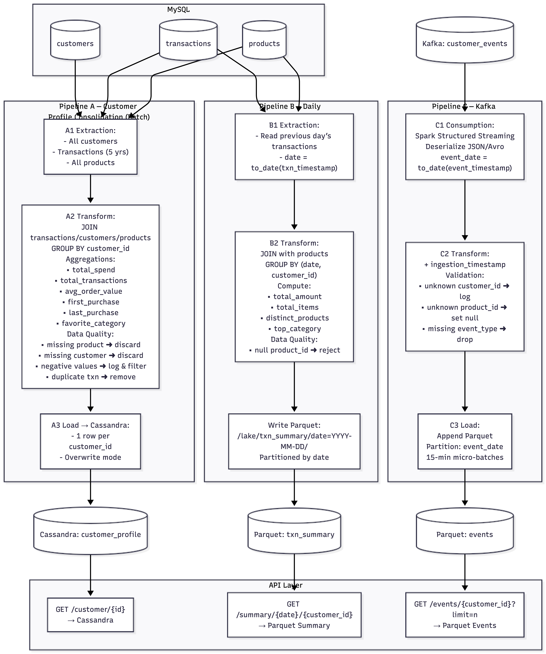
FUNCTIONAL FLOW DIAGRAM
5/21

Slide 6
OVERALL ARCHITECTURE DIAGRAM
6/21

Slide 7
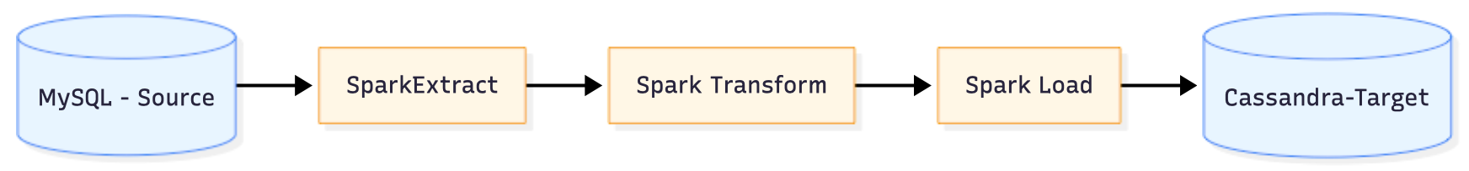

PIPELINE A -CUSTOMER PROFILE CONSOLIDATION(BATCH) - ARCHITECTURE
7/21

Slide 8
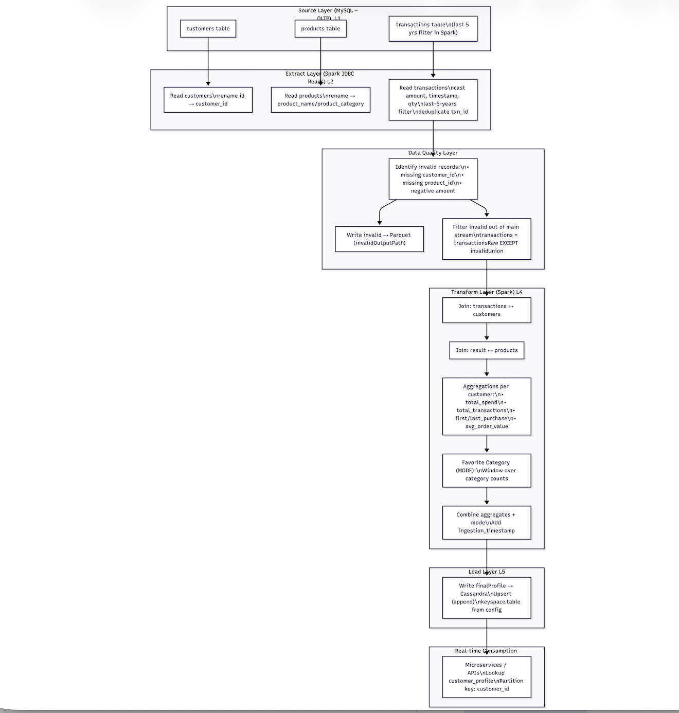
PIPELINE A - FUNCTIONAL FLOW
8/21

Slide 9
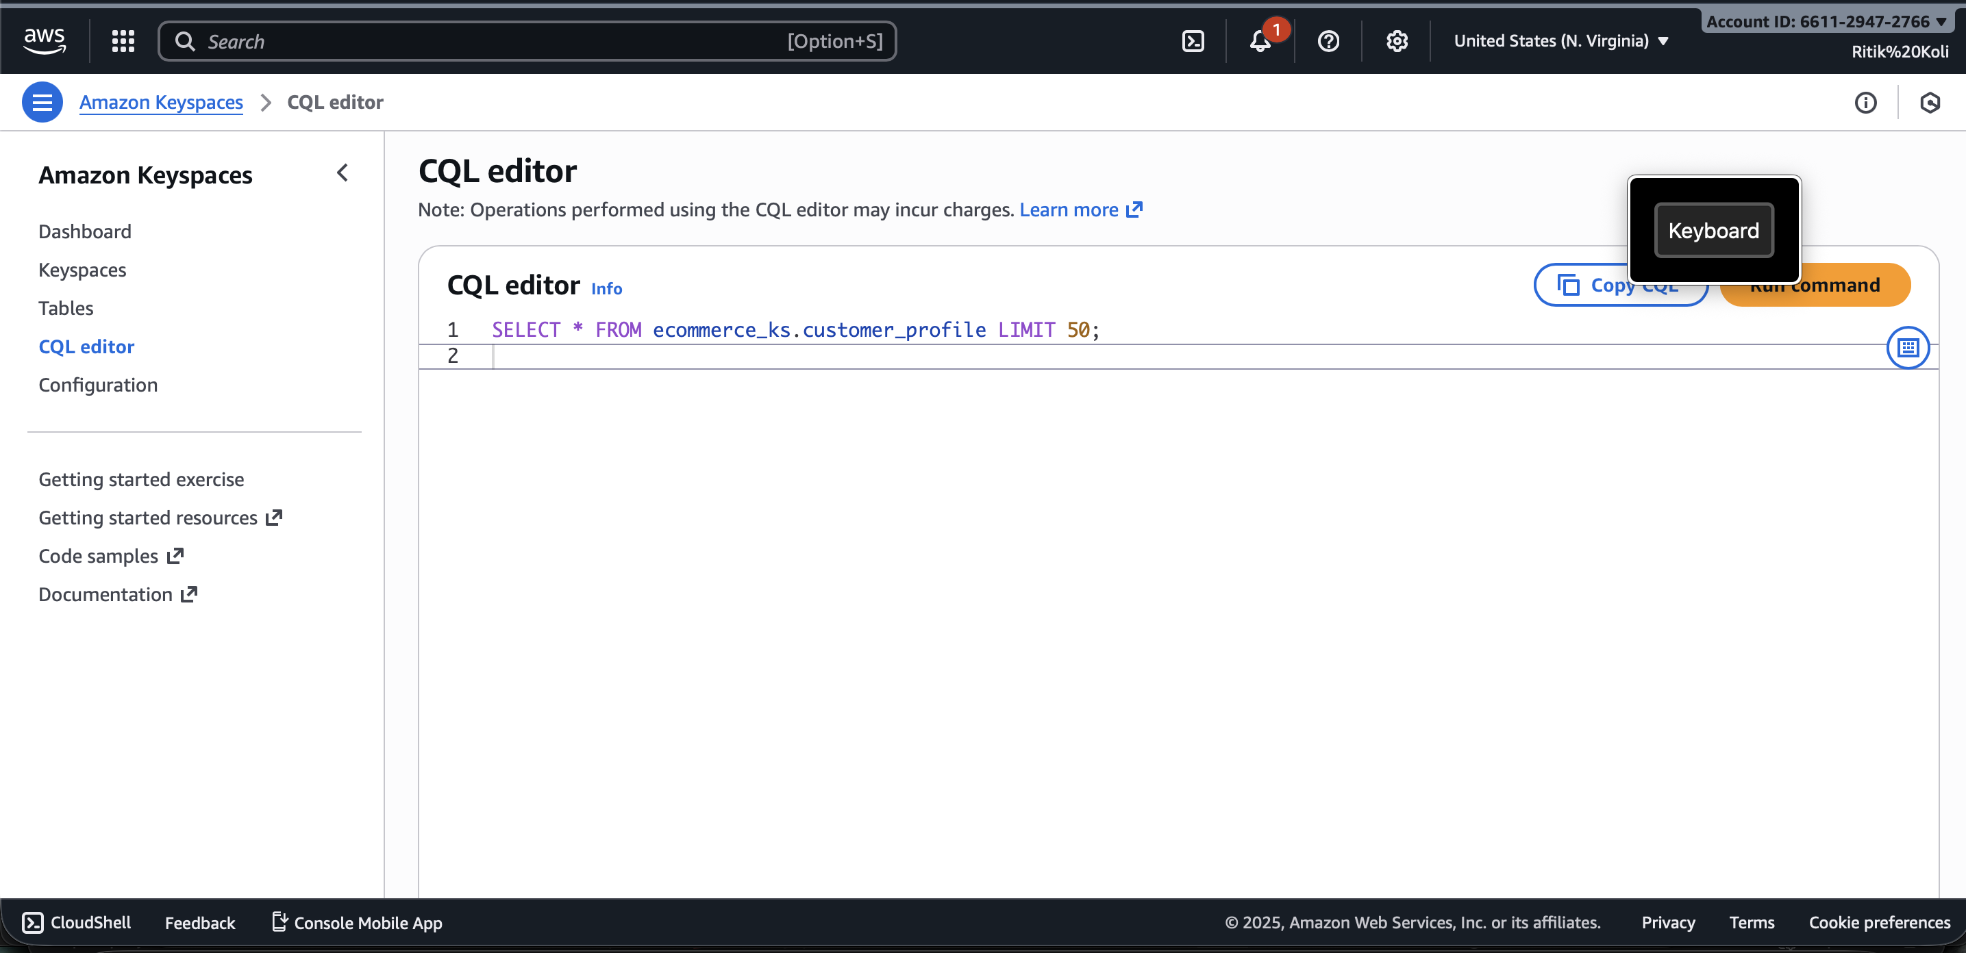
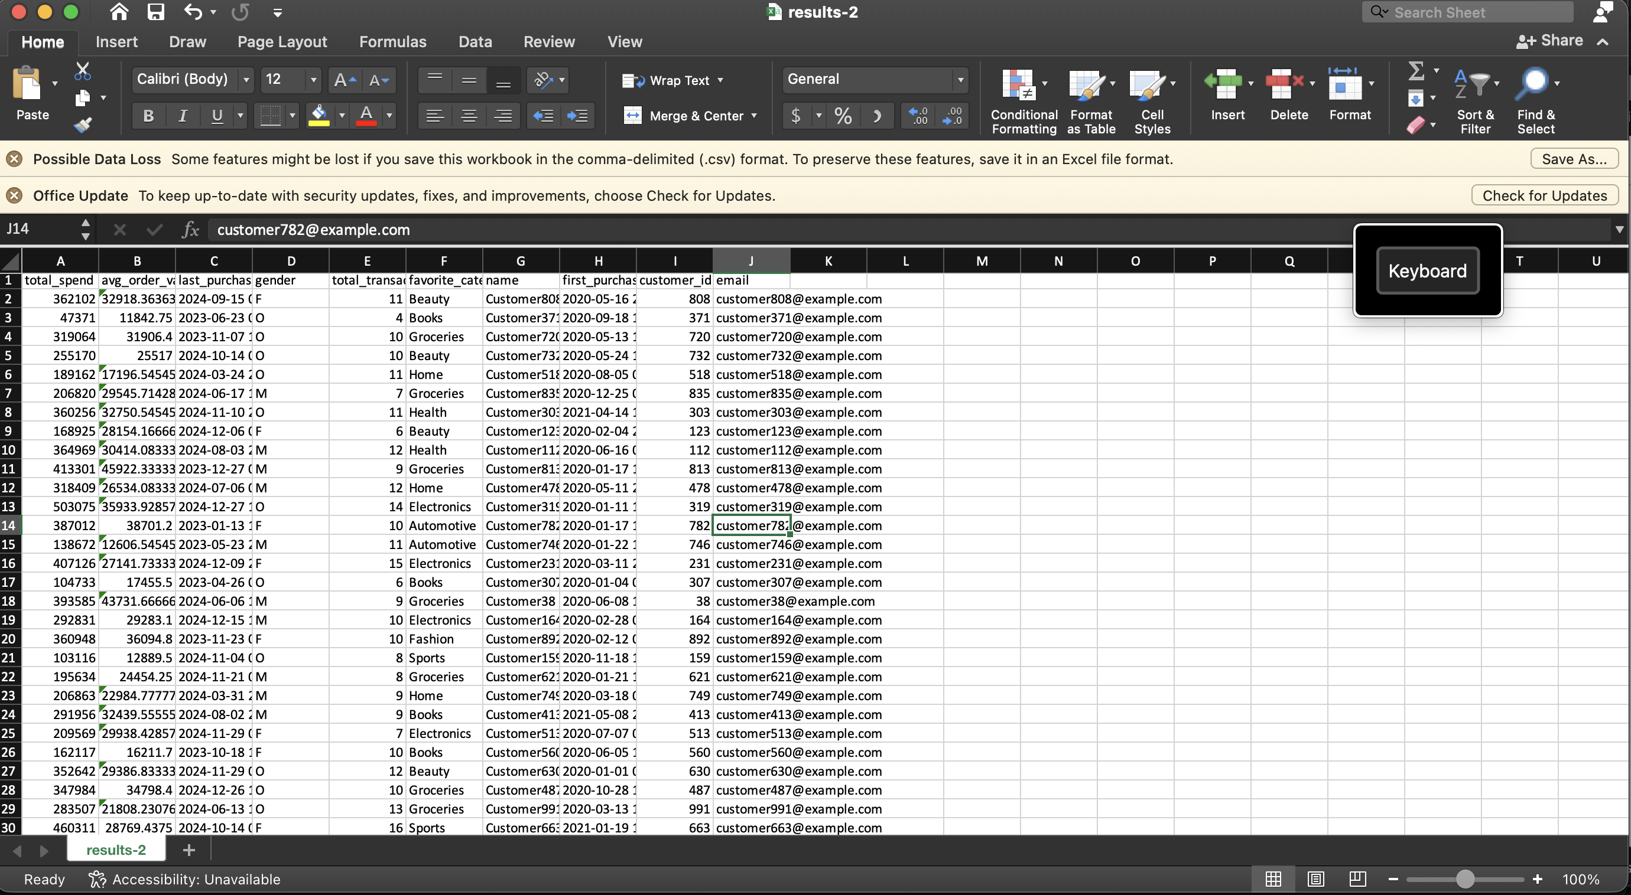


PIPELINE A - OUTPUT
9/21

Slide 10
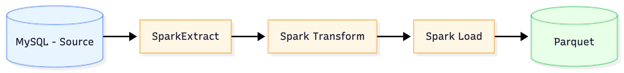
PIPELINE B -DAILY TRANSACTION SUMMARY (BATCH)- ARCHITECTURE
10/21

Slide 11
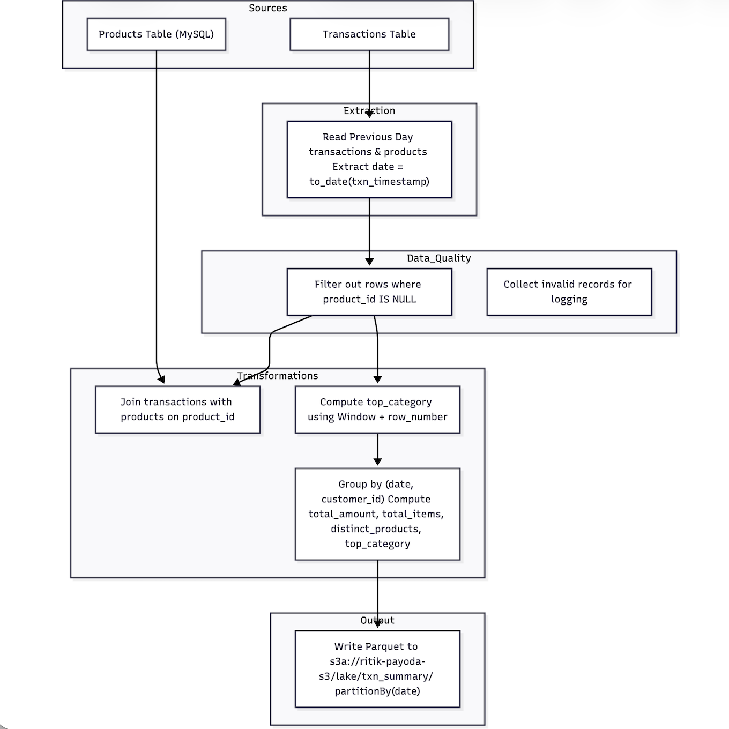
PIPELINE B - FUNCTIONAL FLOW
11/21

Slide 12
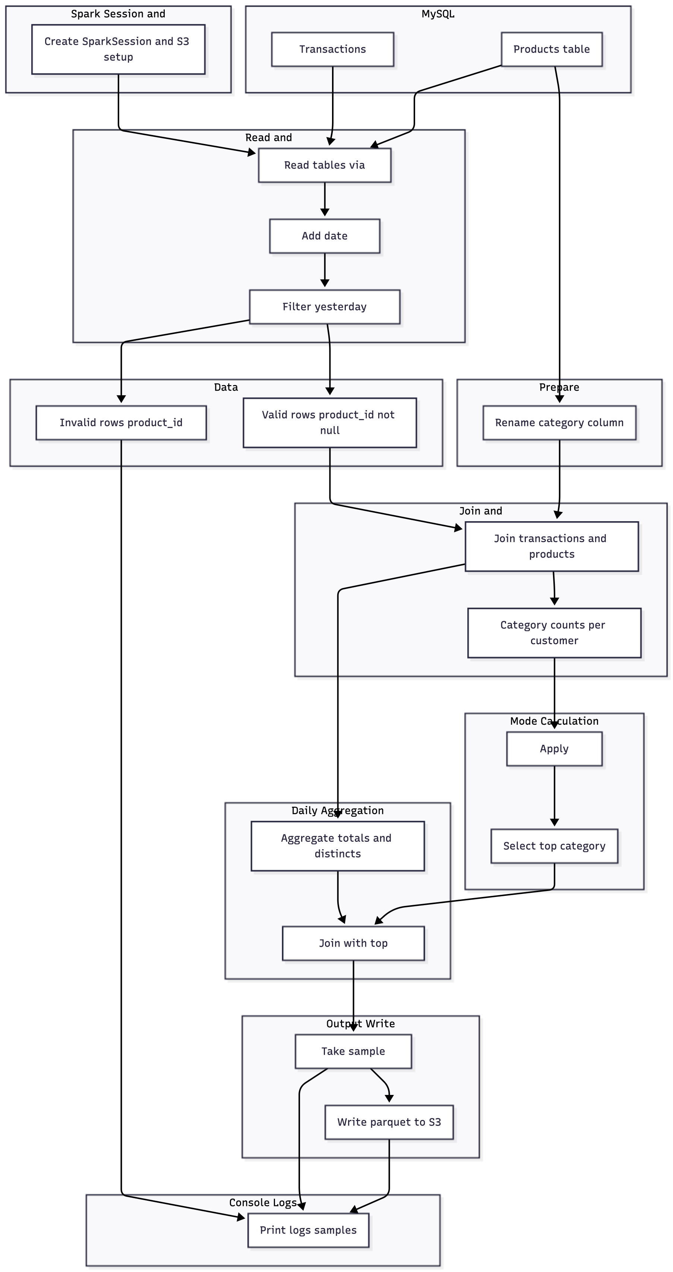
PIPELINE B - FUNCTIONAL FLOW
11/21

Slide 13
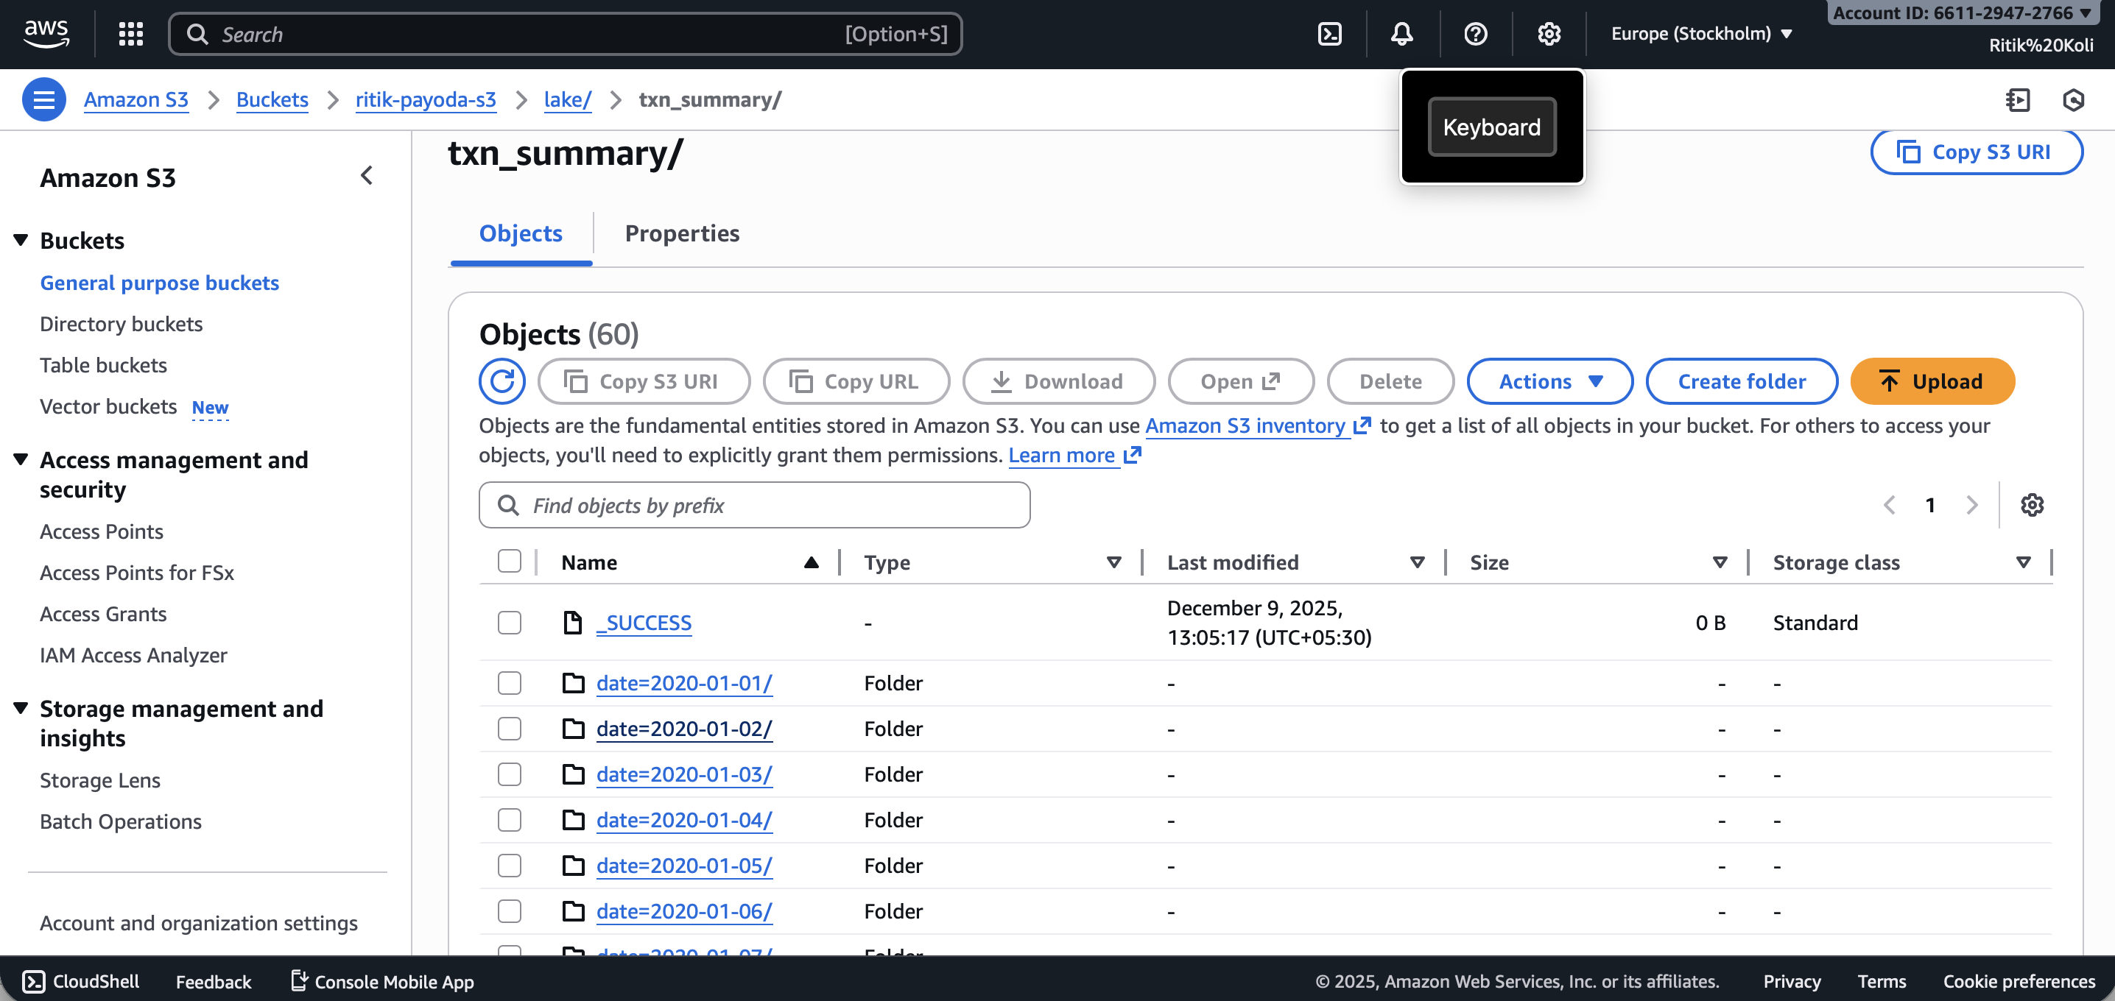
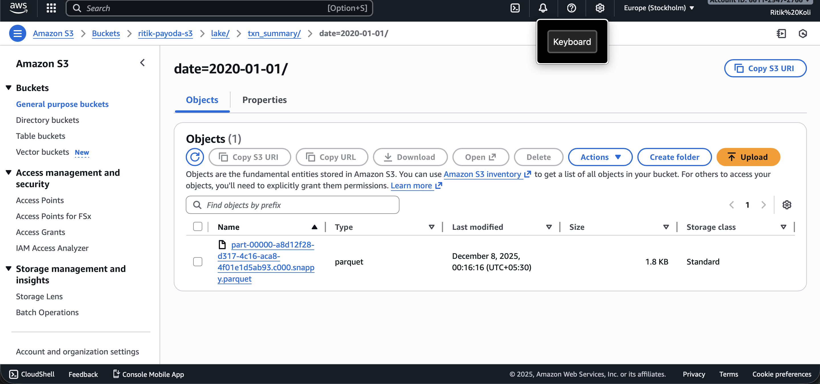
PIPELINE B - OUTPUT
,
,
,
,
12/21

Slide 14
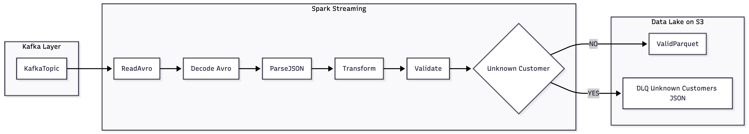
PIPELINE C – KAFKA BEHAVIOUR EVENT ARCHIVAL (STREAMING)ARCHITECTURE
13/21

Slide 15
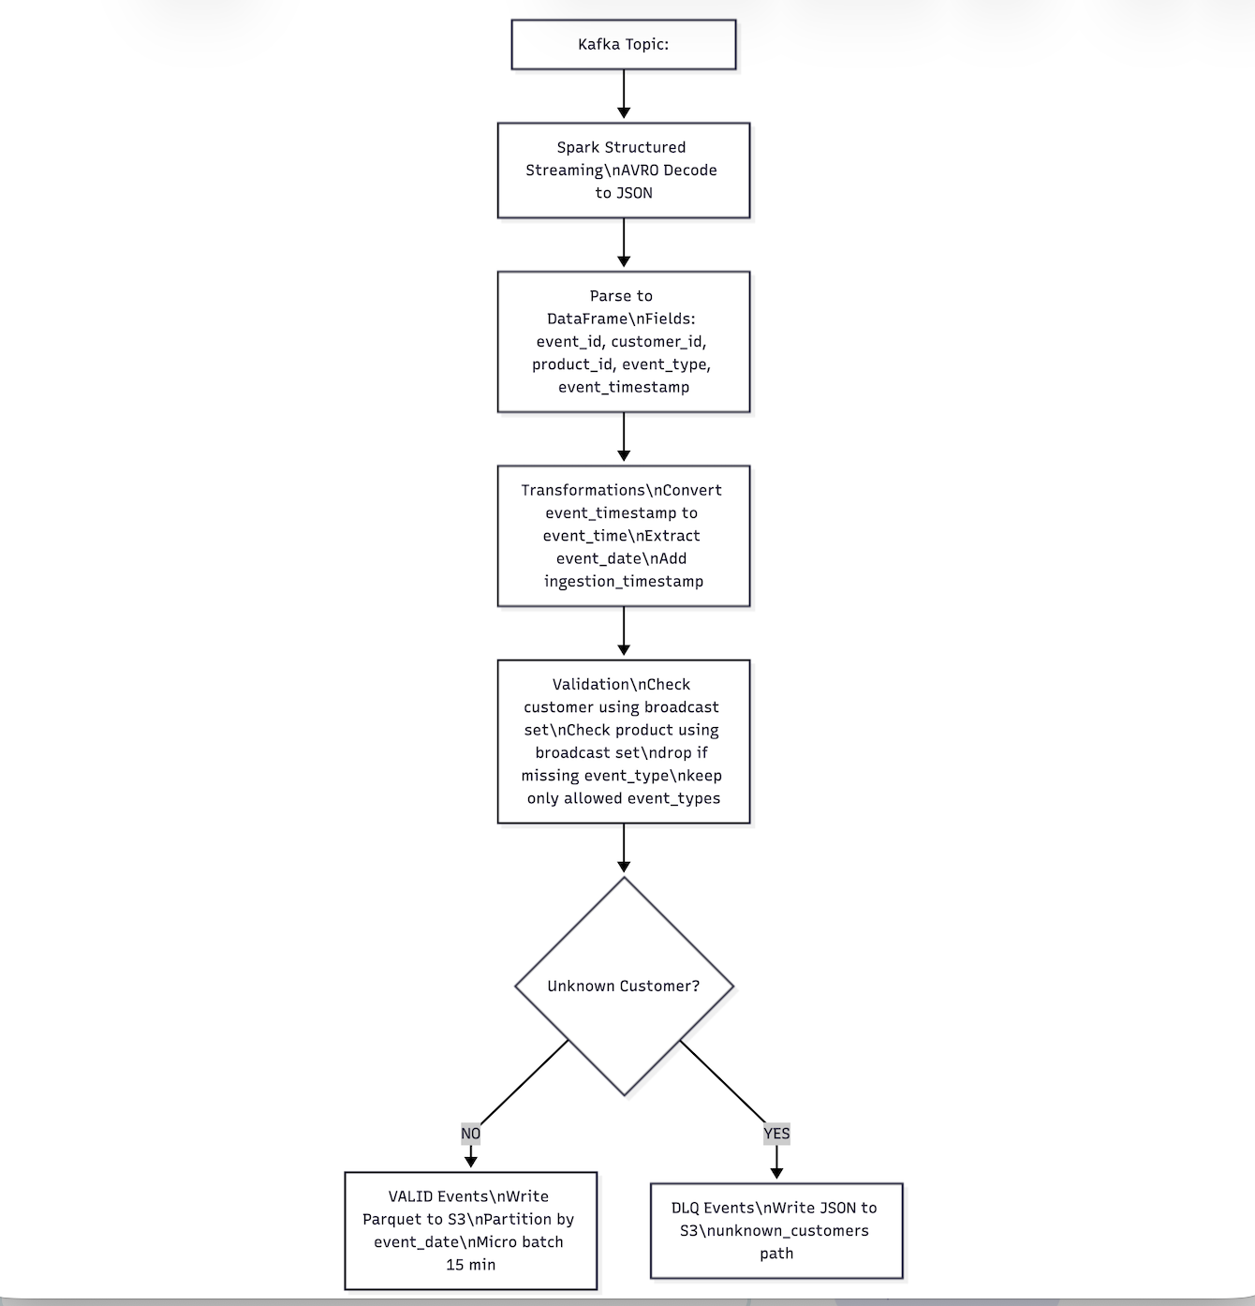
PIPELINE C – FUNCTIONAL FLOW
13/21

Slide 16
PIPELINE C - FUNCTIONAL FLOW
14/21

Slide 17
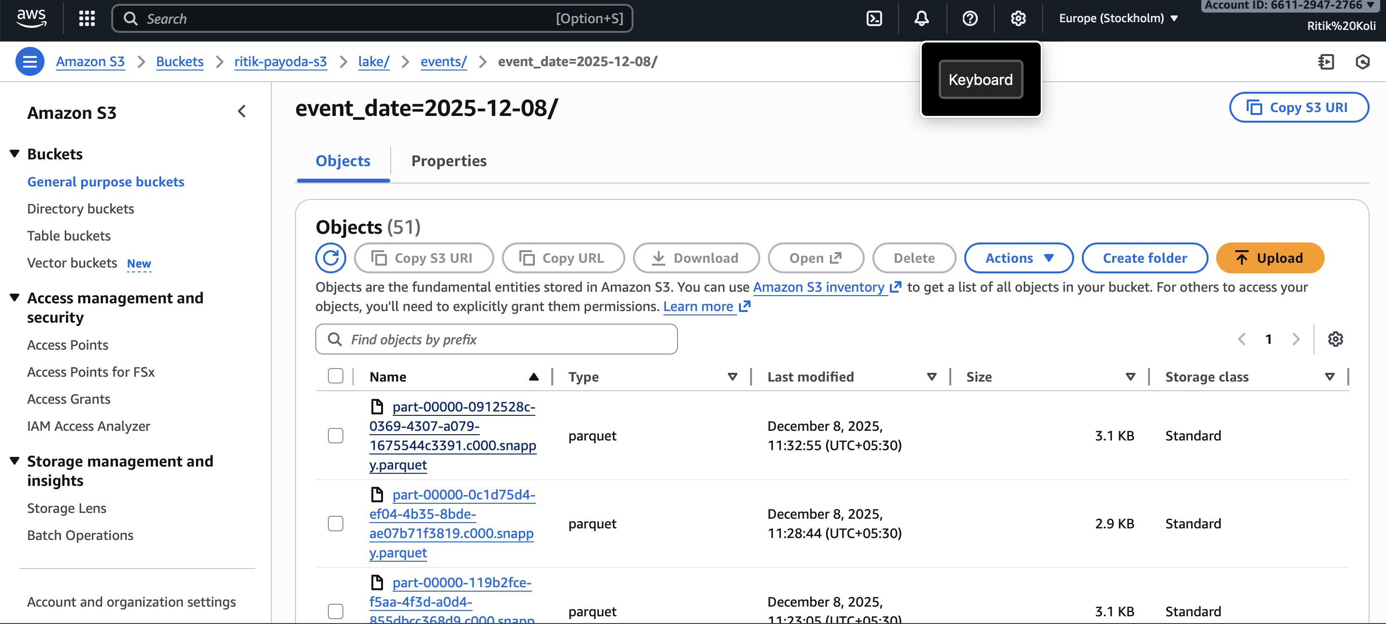
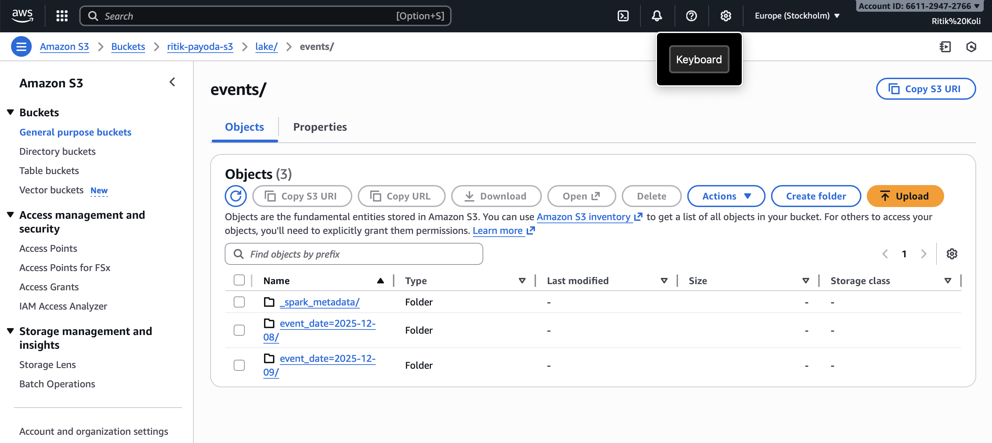

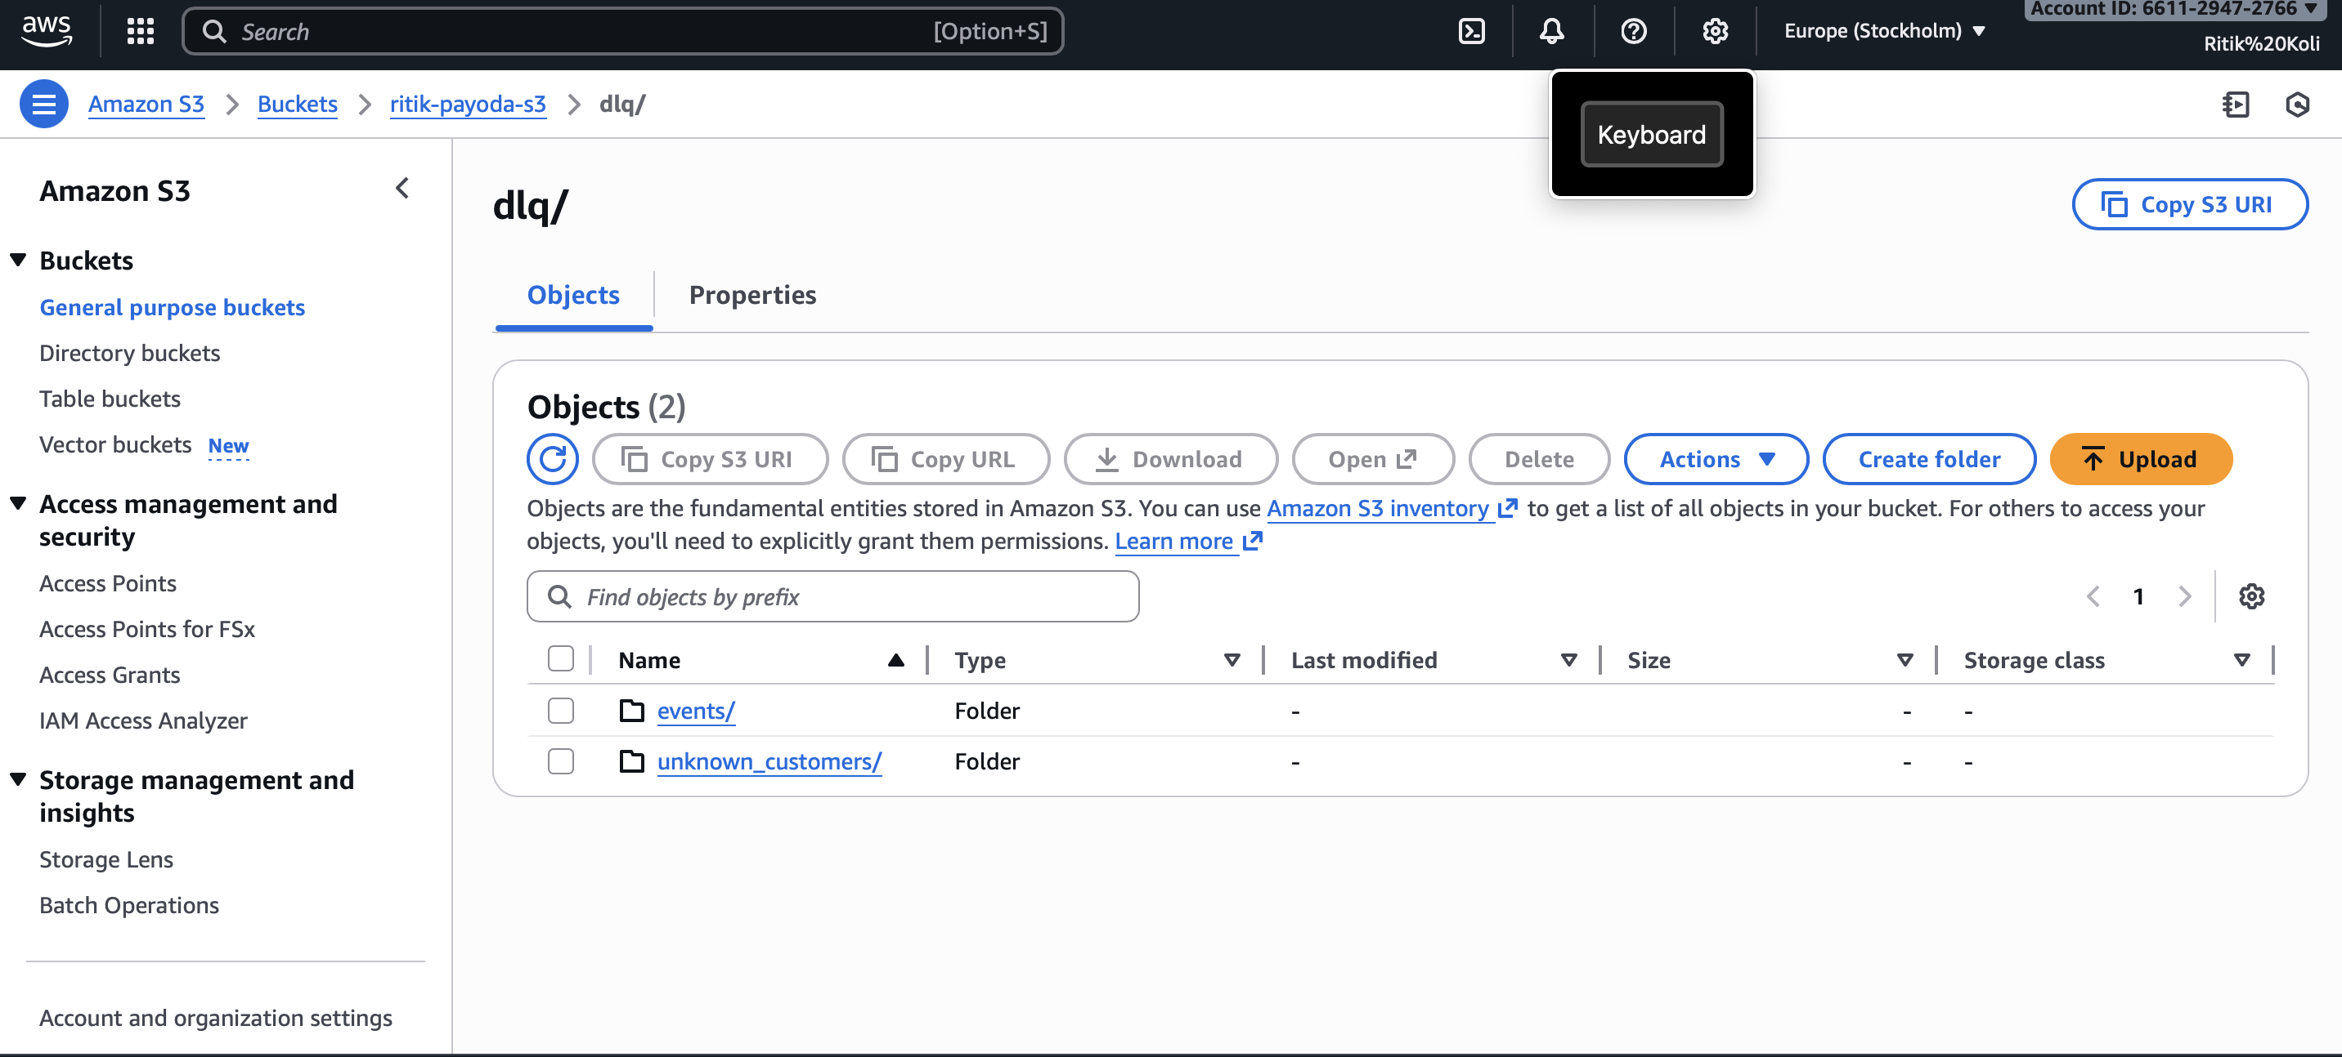
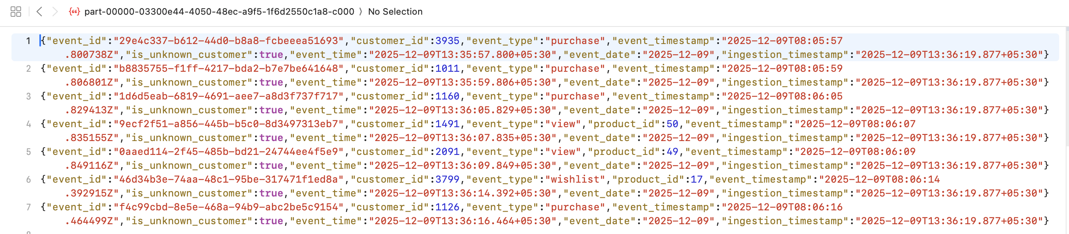
PIPELINE C - OUTPUT

Slide 18


















API LAYER (PLAY FRAMEWORK)
Service Endpoints
API Layer Architecture
GET
/customer/{customer_id}
Returns customer transaction data
Play Framework
Routing
GET
/summary/{date}/{customer_id}
REST Controllers
Endpoint Mapping
Returns customer daily summary
API Layer
GET
/events/{customer_id}?limit=n
Fetch last n behaviour events
Service Layer
Implementation Details
Cassandra
Parquet
Uses ParquetReader (no Spark)
Key Benefits
Row-to-case-class mapping using safe Option wrappers
Supports INT96 timestamp decoding
Lightweight
Type-Safe
Async
16/21

Slide 19






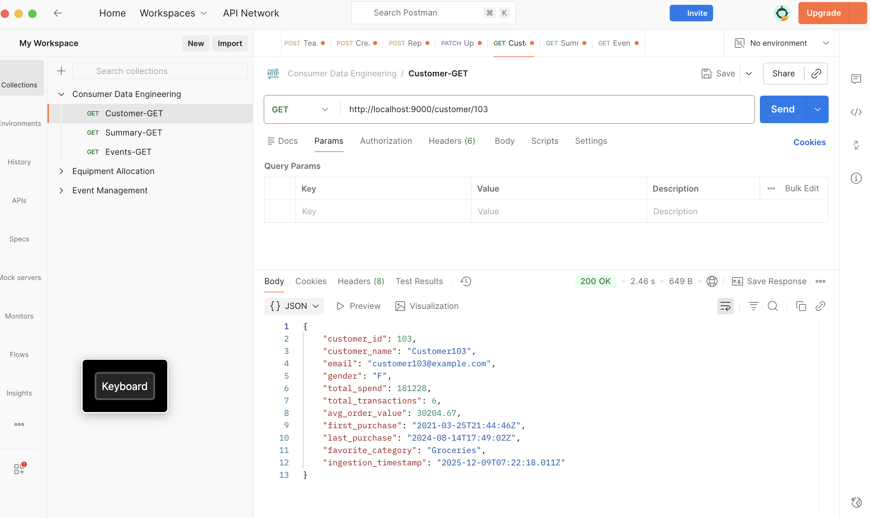
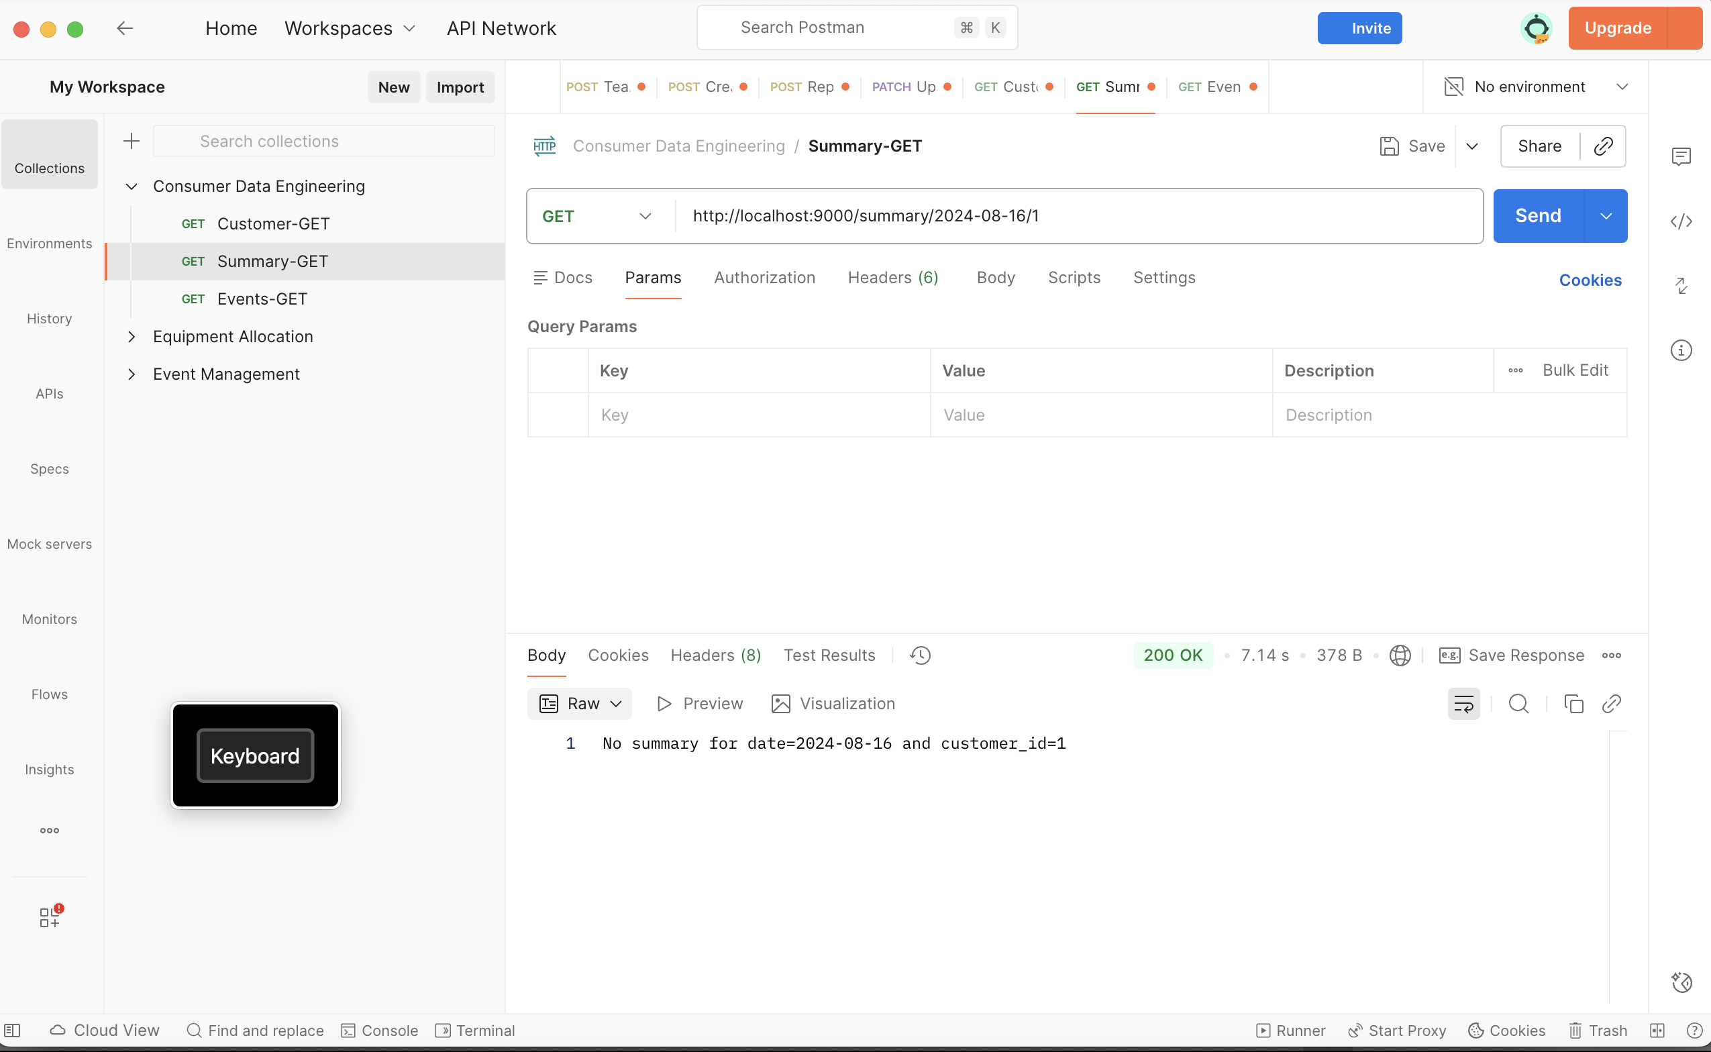
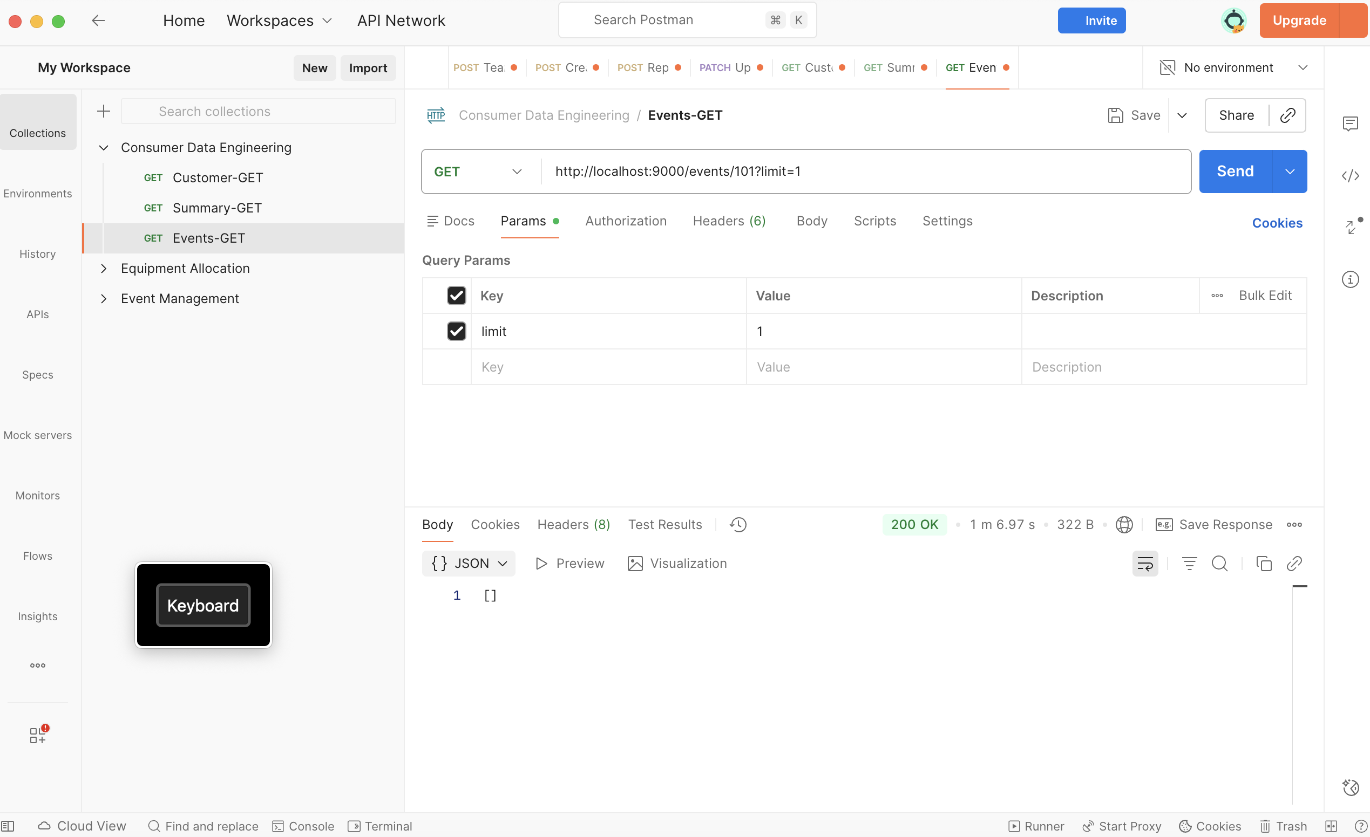
API LAYER OUTPUT
Customer Data
Daily Summary
Behavior Events
GET /customer/{customer_id}
GET /summary/{date}/{customer_id}
GET /events/{customer_id}?limit=n
17/21

Slide 20























DEPLOYMENT PLAN
Endpoints
Implementation
GET /customer/:customer_id
ParquetReader
Returns customer transaction data
Uses ParquetReader (no Spark)
val reader = new ParquetReader.Builder[MyRecord](path) .withTypeInfo(typeInfo) .build()
GET /summary/:date/:customer_id
Row-to-case-class Mapping
Returns customer daily summary
Using safe Option wrappers
val result = Try { MyCaseClass( row.getAs[String]("name"), row.getAs[Option[Int]]("age") ) }
GET /events/{customer_id}?limit=n
Fetch last n behaviour events
INT96 Timestamp Decoding
Support for legacy timestamp format
Deployment Environment
Production: Secure HTTPS endpoints
Key Benefits
Staging: Preview for validation
High Performance
Type Safety
Modular Design
Scalability
18/21

Slide 21














TECH FEATURES IMPLEMENTED
End-to-end multi-source ETL
Real-time + batch pipelines
Data lake design
Unified data processing from multiple sources with consistent data models and transformations.
Hybrid data processing architecture supporting both real-time stream processing and traditional batch jobs.
Centralized data repository with optimized storage formats for various data types and access patterns.
Precomputed customer profiles
Behaviour event archival
REST API exposure
Aggregated customer data materialized for faster query response and personalized customer experiences.
Comprehensive logging and storage of customer behavior events for analytics and historical analysis.
Lightweight, scalable RESTful APIs for efficient data access and integration with client applications.
Complete end-to-end data engineering solution with scalable architecture, efficient data processing, and accessible APIs.
19/21

Slide 22













CONCLUSION & FUTURE SCOPE
Project Summary
Future Scope
Successfully built a unified consumer data ecosystem that consolidates customer master data, transactions, and behavioral events into a cohesive platform.
Enhanced Analytics
Implement advanced ML models for customer behavior prediction and segmentation
Key Achievements
Streaming Enrichment
Add real-time data enrichment capabilities for immediate customer insights
End-to-end multi-source ETL implementation
API Gateway
Implement comprehensive API gateway with rate limiting, caching, and monitoring
Real-time + batch data processing pipelines
Cloud Migration
Data lake design with Parquet storage
Migrate to cloud platform for scalable infrastructure and global accessibility
Precomputed customer profiles for faster access
Data Quality Framework
Implement comprehensive data quality monitoring and alerting system
Behaviour event archival system
Strategic Vision
REST API exposure for data consumption
Transform this ecosystem into a comprehensive customer data platform that powers personalized experiences across all touchpoints.
20/21

Slide 23
THANK YOU
21/21

